Slide 1



Slide 2


Slide 3
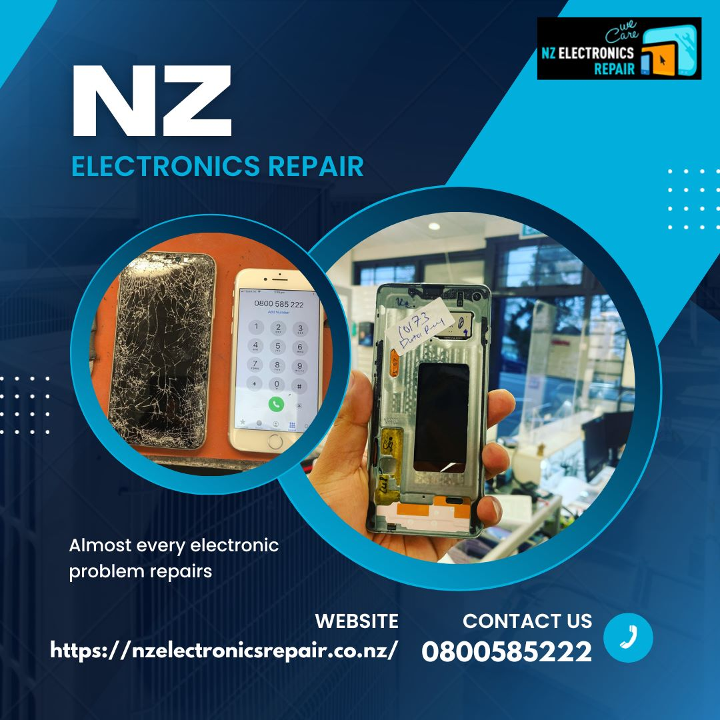

Slide 4
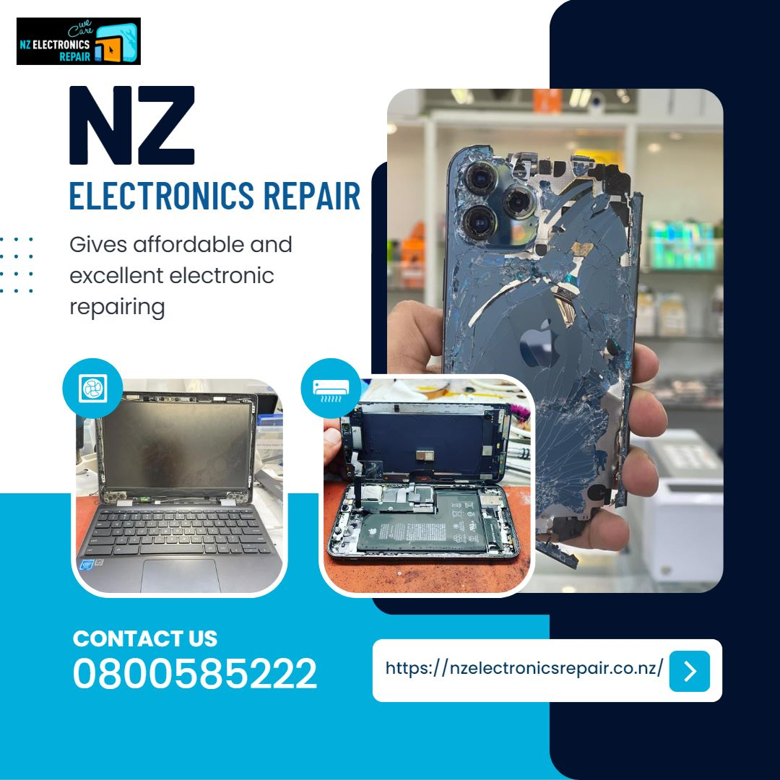


Slide 5


Slide 6
For Fast And Affordable Repair Visit NZ ELECTRONICS REPAIR

